Slide 1
Parser
Group 5

Slide 2
What is a Parser?
Parser is a component of compiler breaks the data into smaller elements coming from lexical analysis phase. A parser takes input in the form of sequence of tokens and produces output in the form of parse tree.

Slide 3
Bison
For Lexical analyzer, our language uses flex. With flex, bison is often used to provide Bison with tokens for token wise input data.
We are generating LALR(1) parser using Bison.

Slide 4
Bison
Bison takes the parser specification from a file. Following the convention of yacc the file name should end with .y a. The output file name by default uses the prefix of the input file and is named as .tab.c b . The output file generated by yacc is named as y.tab.c. The Bison with -y command-line option will also generates this.

Slide 5
What we use: Flex/Flex++
We also added Ganitham-specific keywords like Alphabet, Graph and Set.
We also modelled a lexer in C++, to expose ourselves to the diversity of thought associated with coding a lexer in multiple languages.

Slide 6
Flex++ Specific Features
C++ makes it easy to create a hashmap through the usage of std::unordered_map<> . This allows us to create a symbol table of the encountered identifiers, thus anonymising the programmer’s variable names. This will also be useful in the later stages, as it gives a predictable format for the identifier tokens.
Using an unordered_map provides the advantage of O(1) avg lookup and insertion times, thus keeping the pace close to the implementation without symbol tables.

Slide 7
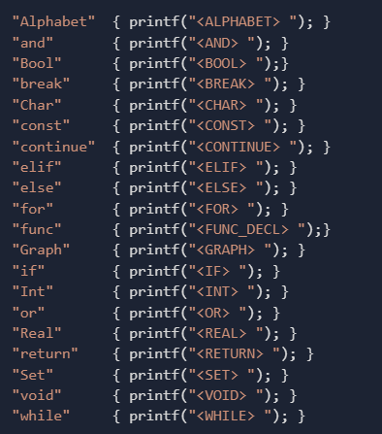
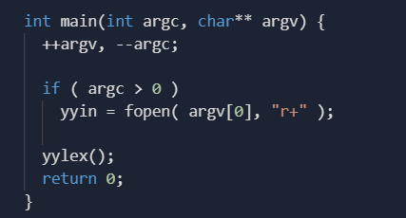
Code

Slide 8
Thank You

